Slide 1
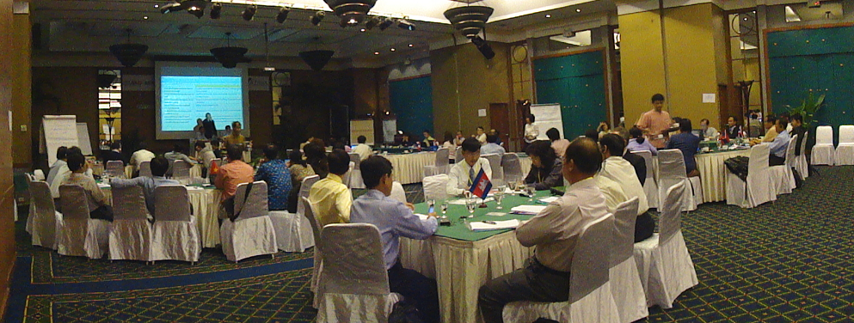
Technical and Planning Workshop on Joint
Cross Border Coordinated Response to an Outbreak of Zoonotic Disease
Communication
June 29- July 2, Phuket , Thailand

Slide 2
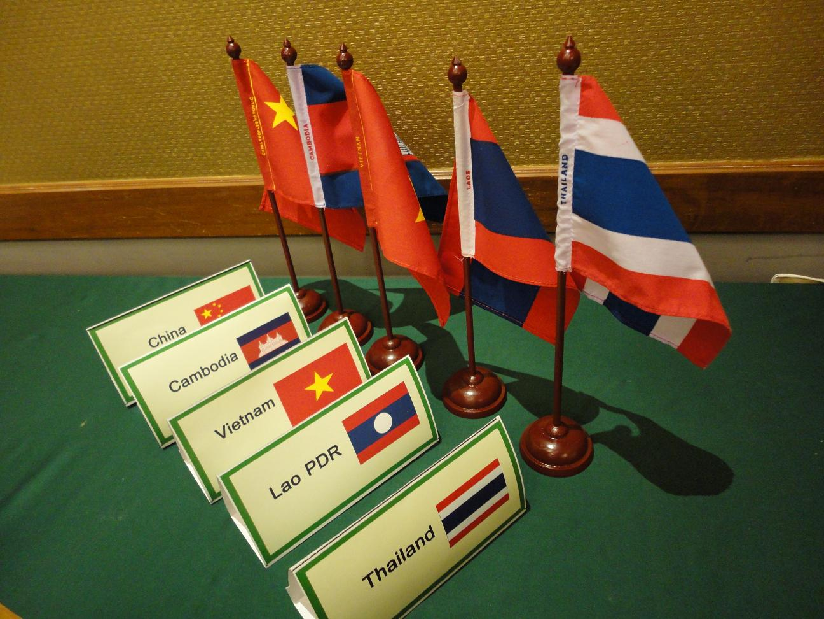




Co-sponsored by
Participated in by 80 representatives from countries – China, Cambodia, Vietnam, Lao PDR and Thailand.

Slide 3
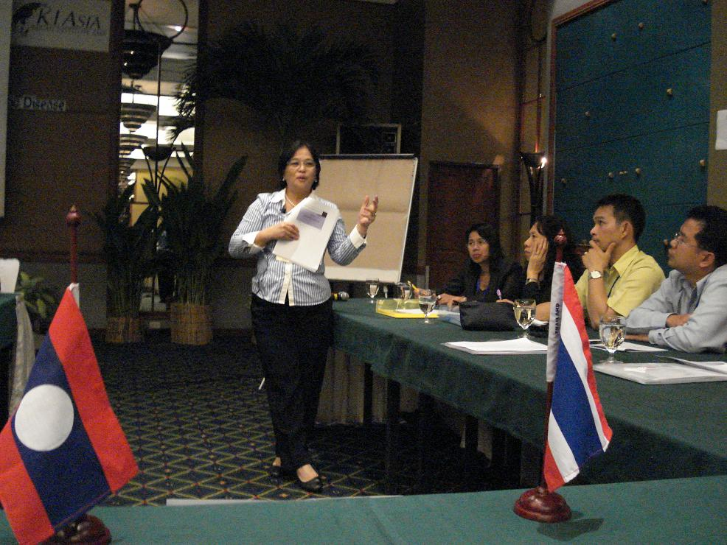
Objectives
The session on Communication was facilitated by AED Country Coordinator for Lao PDR, Cecile Lantican. The session was designed to:
To review some communication principles that would guide participants how to communicate and respond effectively to those in need during times of crisis and/or emergencies
To gain understanding on the practical applications of these principles through use of examples (case studies).

Slide 4
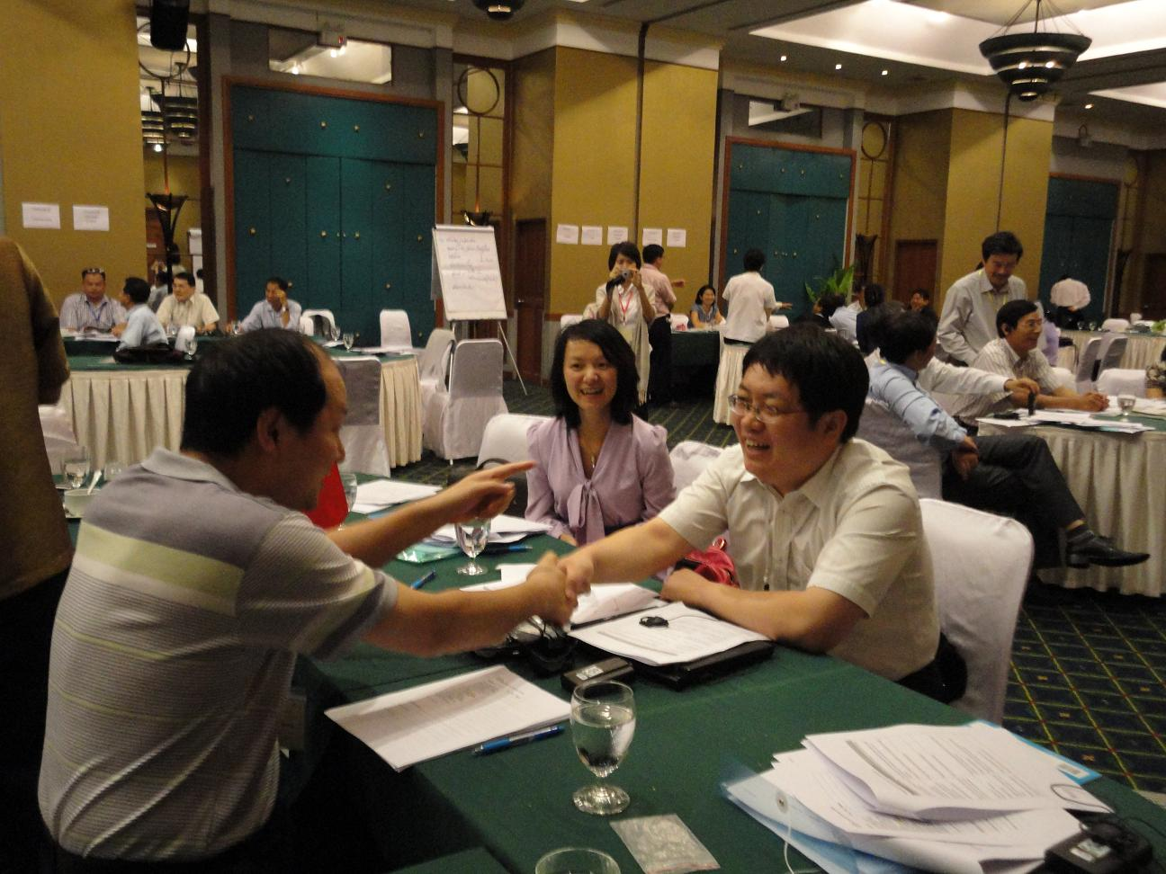
Communication sessions
Session 1 – Communication overview and communication principles
Session 2 – Communicating to the community
Session 3 - Message packages

Slide 5
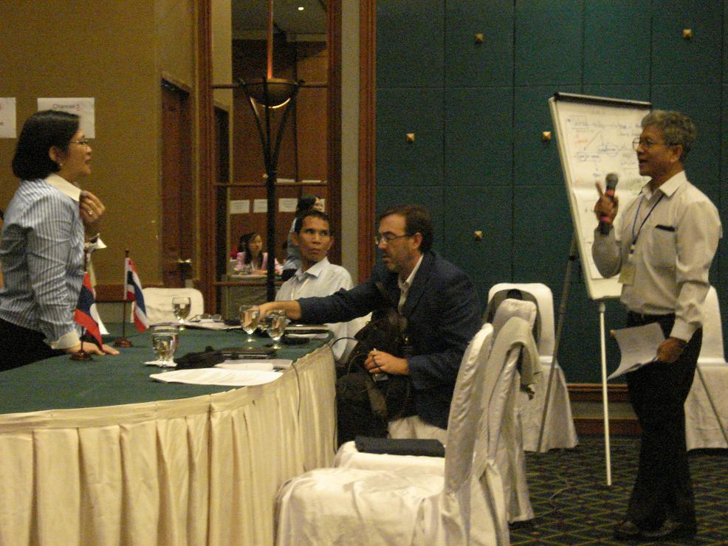
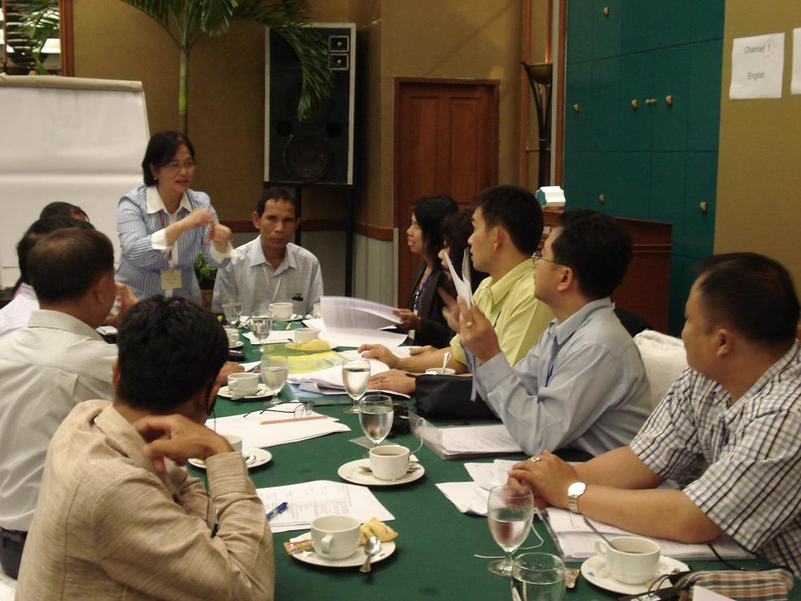
Communication overview
A discussion of :
communication defined, risk communication, emergency communication
and communication principles.

Slide 6
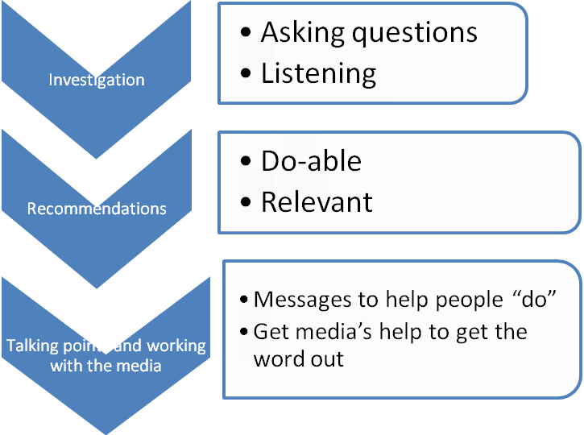
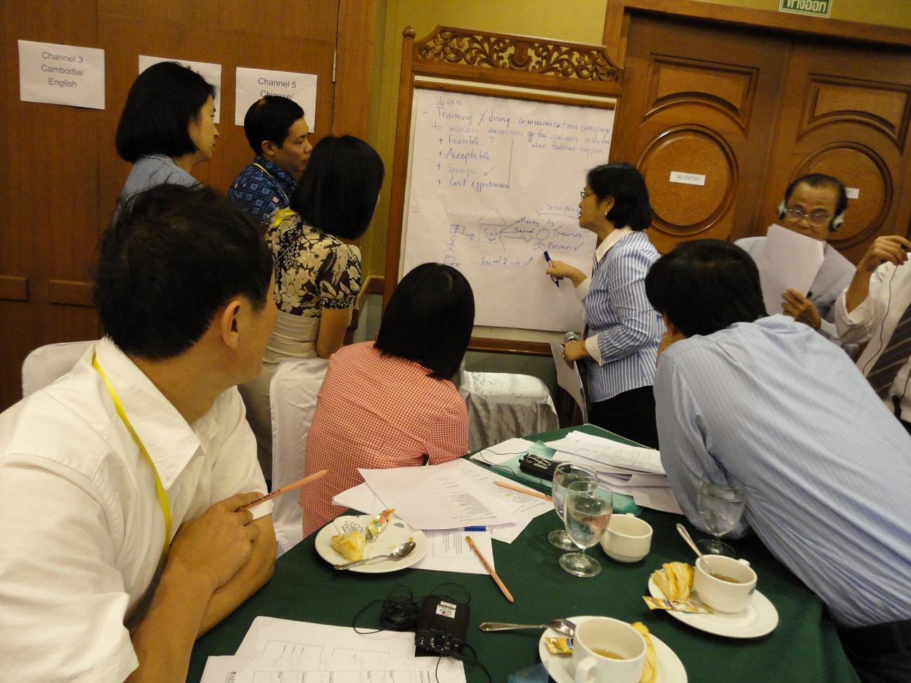
Communication during outbreak
“Communication at each step of your work”

Slide 7
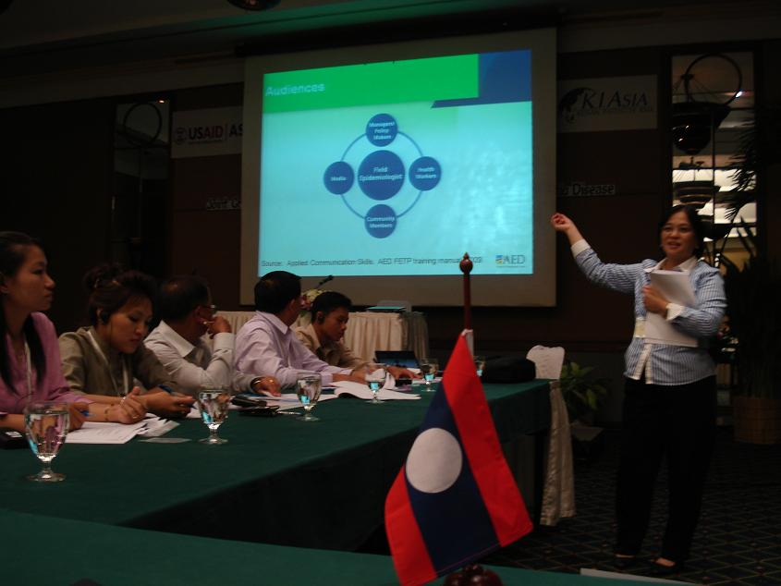
Communicating to the community
Using the graphic, participants were asked who they communicate during their work.
During their investigation in the community, they were asked how do they shape their questions? How do they make their respondent comfortable and open to share information?
.

Slide 8
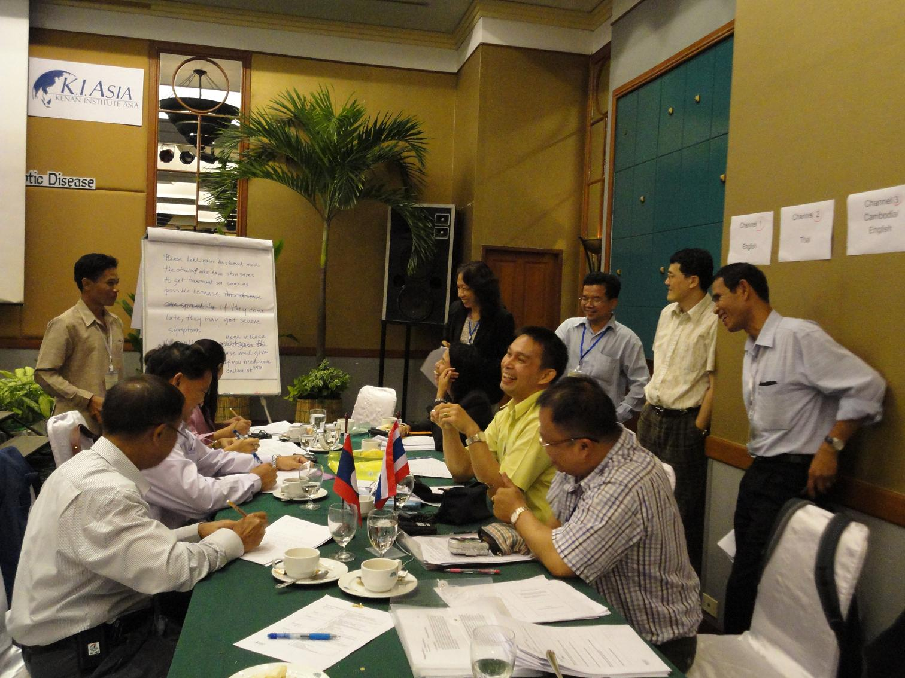
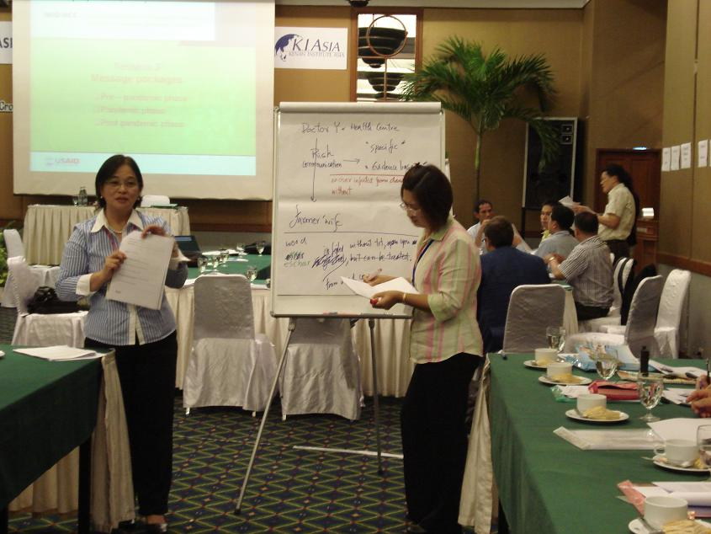
Communicating to the community
Using interpersonal communication skills -- active listening, asking questions, probing and use of simple language

Slide 9
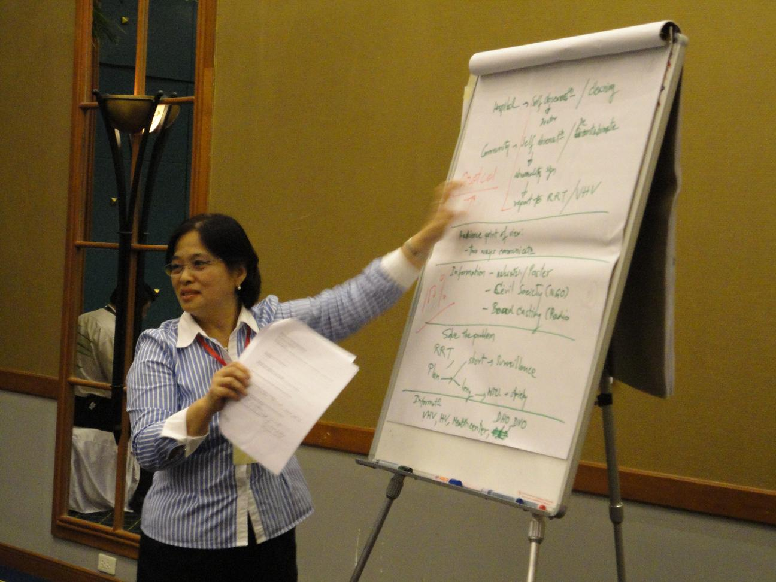
What are do-able recommendations?
Look for:
Evidence --- taking these actions can stop or slow outbreak.
Actions are consistent with peoples’ beliefs and values
People see benefit for them
People have the knowledge and skills to do the actions
People have the resources
Credible people support the actions

Slide 10
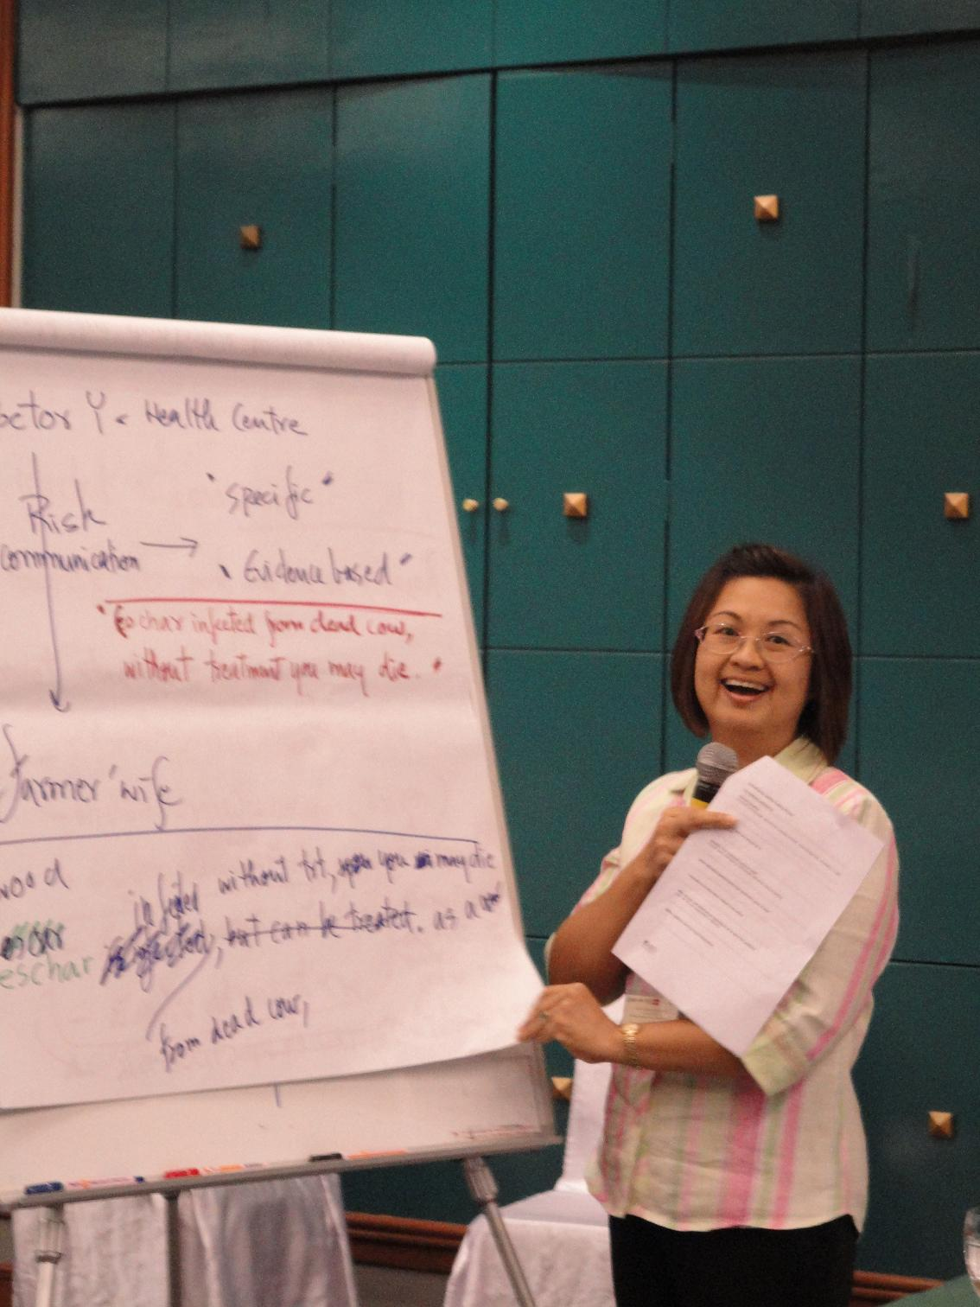
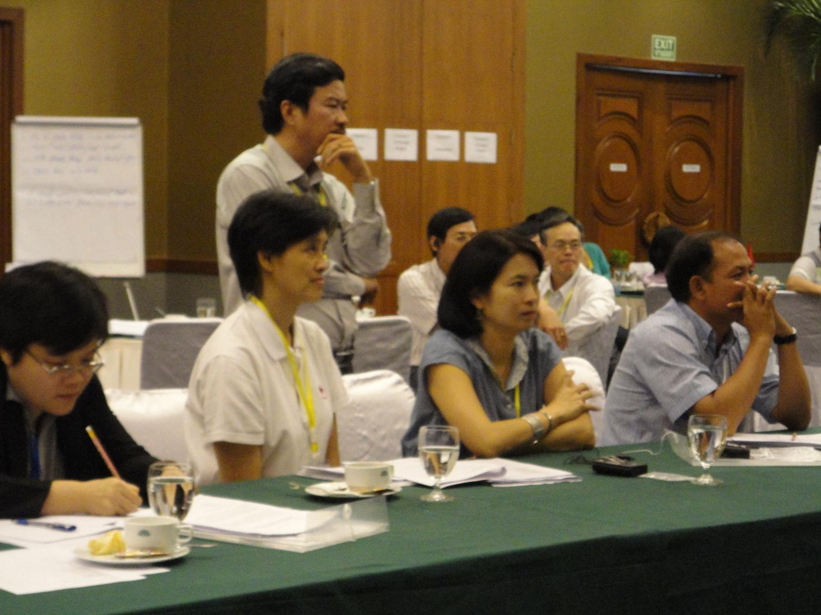
Making do-able recommendations
Using the criteria sheet, participants reviewed recommendations if do-able. Having the skills to analyze evidence from the investigation , it will be easier to communicate those to target groups.

Slide 11
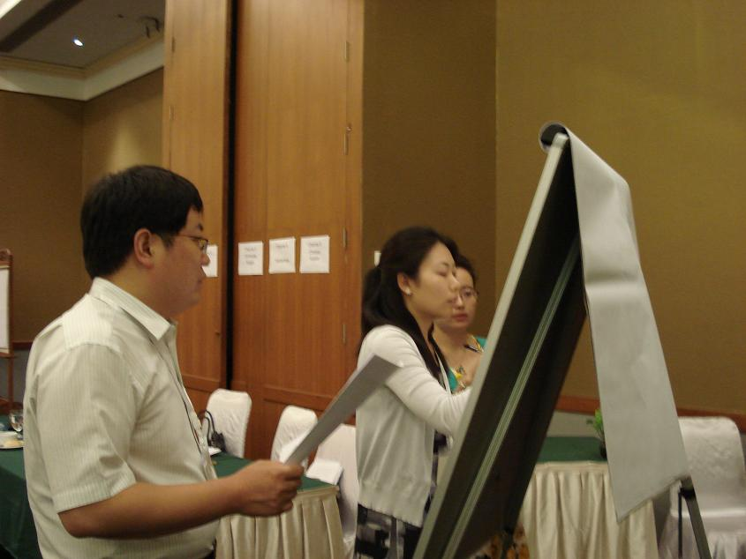
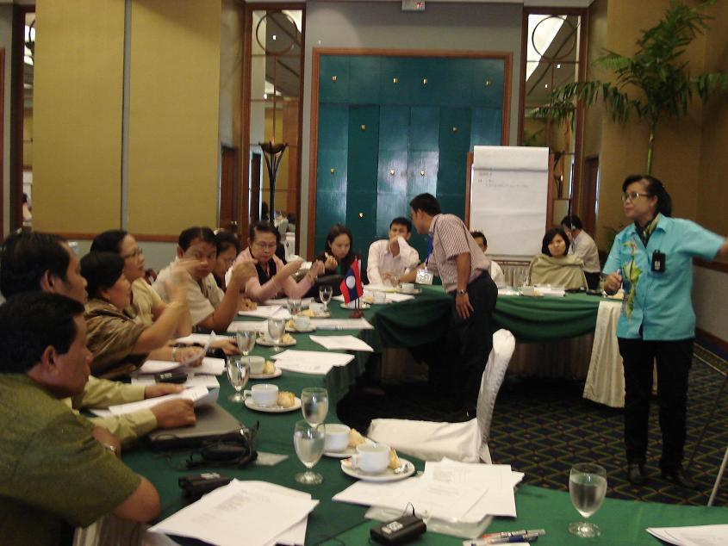
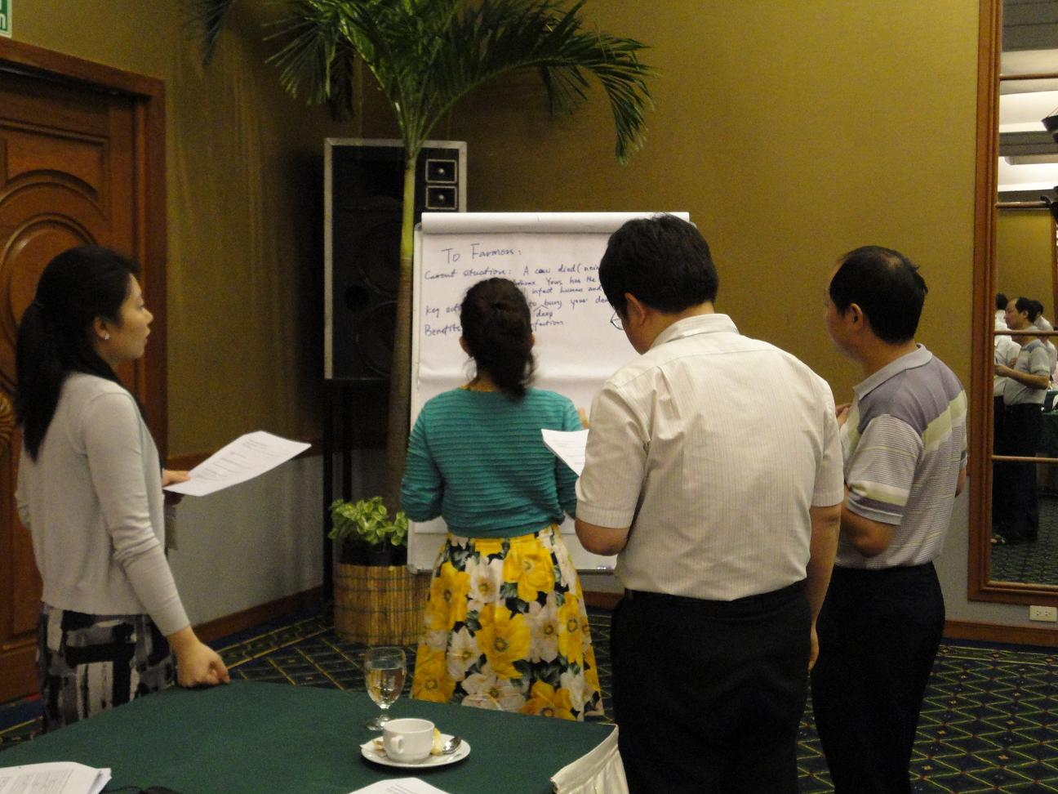
Drafting “Talking Points”
“Talking points are messages you deliver to address people’s concerns, clarify mis-information and motivate them to take actions during outbreak. ”

Slide 12
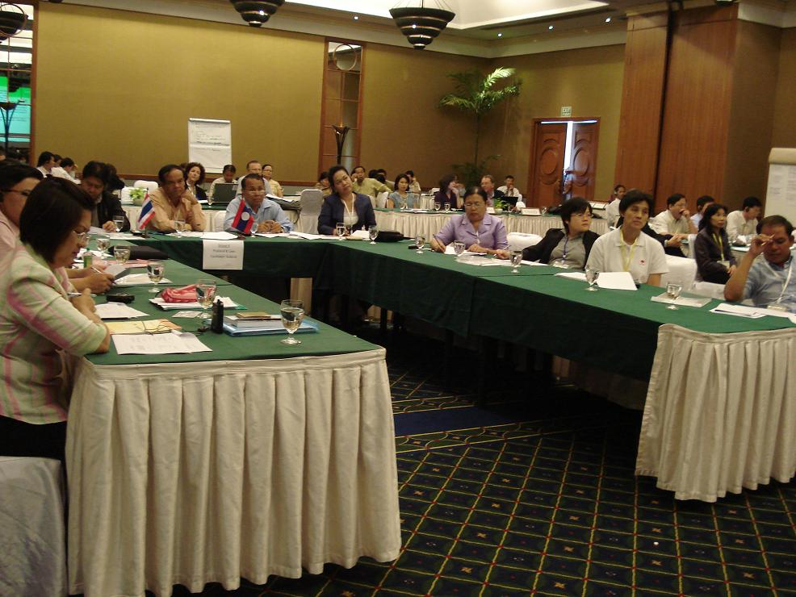
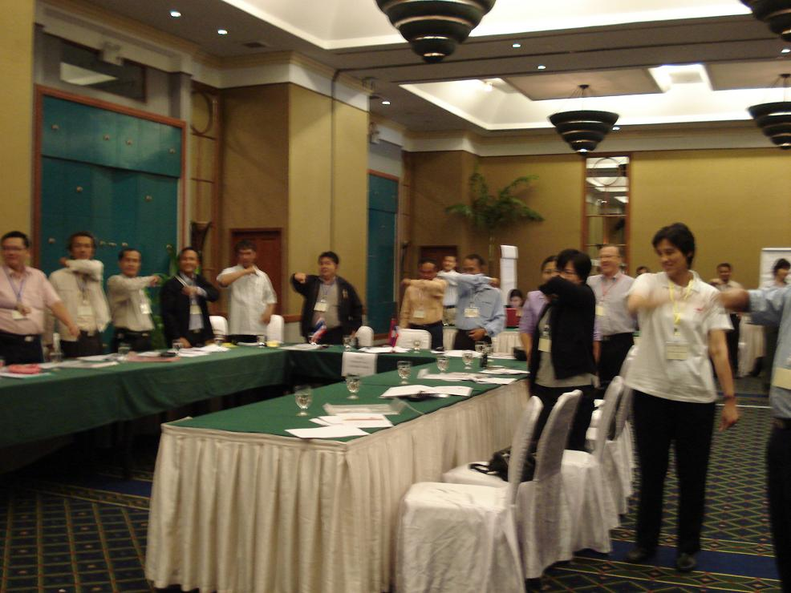
Energizer
Feeling sleepy? Let’s do “”Do it with our sleeves” exercise.

Slide 13
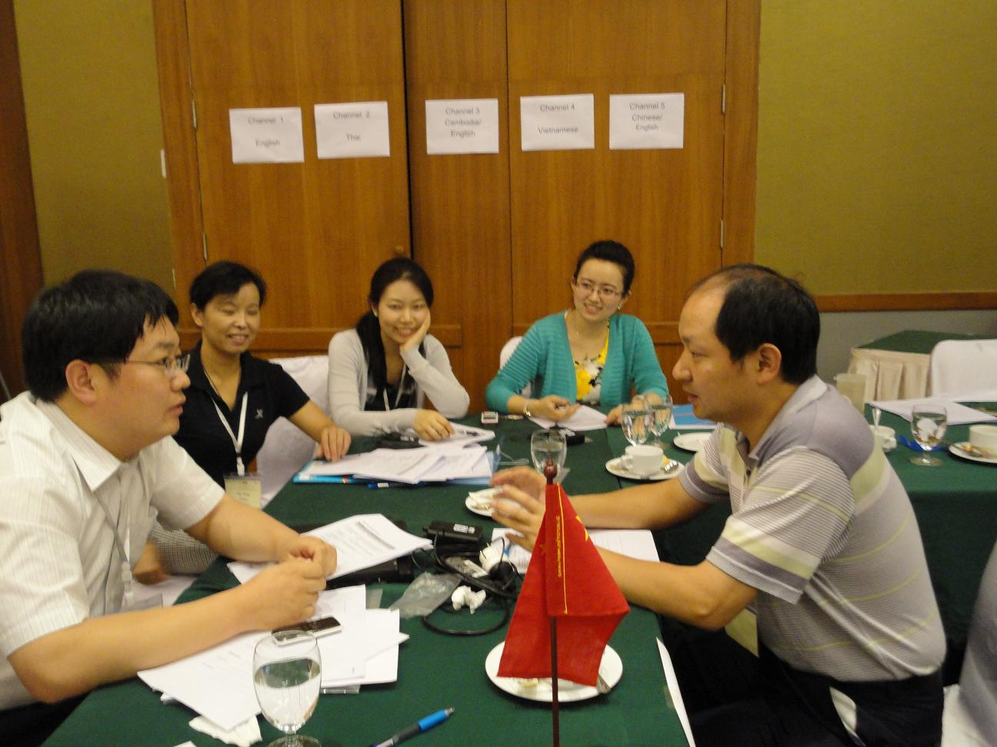
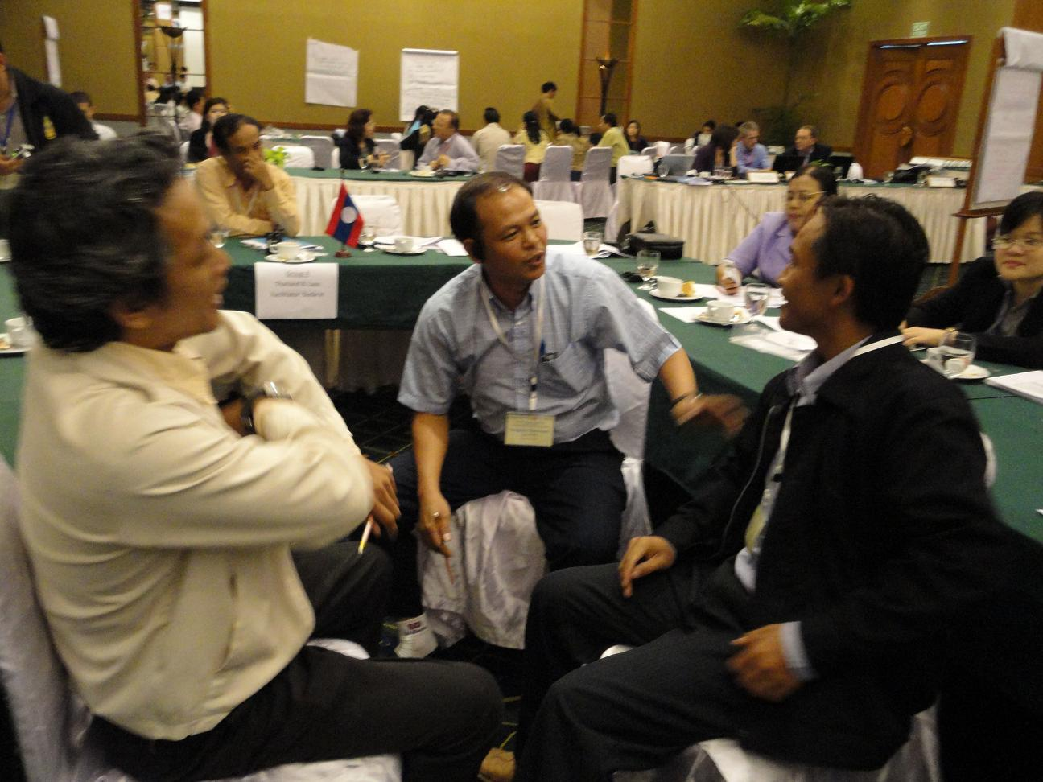
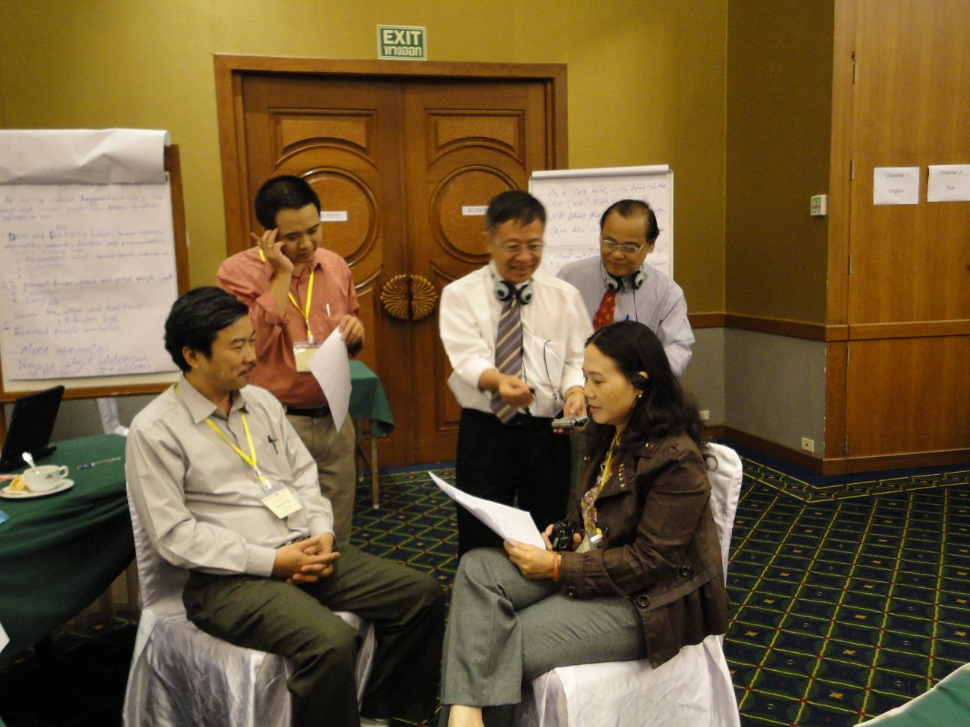
Practice in pairs
Role play – Active listening between a provincial veterinary officer and farmer

Slide 14
Challenges
The time allotted for the Communication was too short to deliver the prepared agenda. The time allotted was only good enough to review doable recommendations and draft talking points, but not enough time to share the experiences.
The simultaneous interpretation for the participants in their languages sometimes create nuisance in the training room.
Should the anthrax case study been done earlier, the communication issues have been integrated and discussed extensively during the training session.
Should the anthrax case study been done earlier, the message packages for the disease have been developed (instead of those earlier prepared which were more associated with H1N1).

Slide 15
Recommendations
In similar trainings in the future, the communication concern/component must be integrated in the case study from the start it is being drafted.
The communication concern/component should also be given emphasis during Day 3 of the training, which is planning for the simulation exercise.

